Slide 1

Laptop Analysis
Sakthi Aravind K
DA&DS
15-04-2025

Slide 2

Introduction
Project Overview:
This project involves performing an Exploratory Data Analysis (EDA) on a comprehensive laptop dataset to uncover patterns and insights related to specifications and pricing.
Objective:
Identify key factors that influence laptop pricing.
Understand consumer preferences based on specifications such as RAM, processor type, and storage.
Utilize statistical analysis and data visualization techniques to derive meaningful insights.
Provide recommendations for manufacturers and consumers based on the analysis.​

Slide 3

Data Understanding
Dataset Description: The dataset comprises various laptop models with attributes such as brand, processor type, RAM, storage, screen size, weight, and price.
Key Variables:
Brand, Processor
RAM, Storage
Screen Size
Weight
Price.​

Slide 4

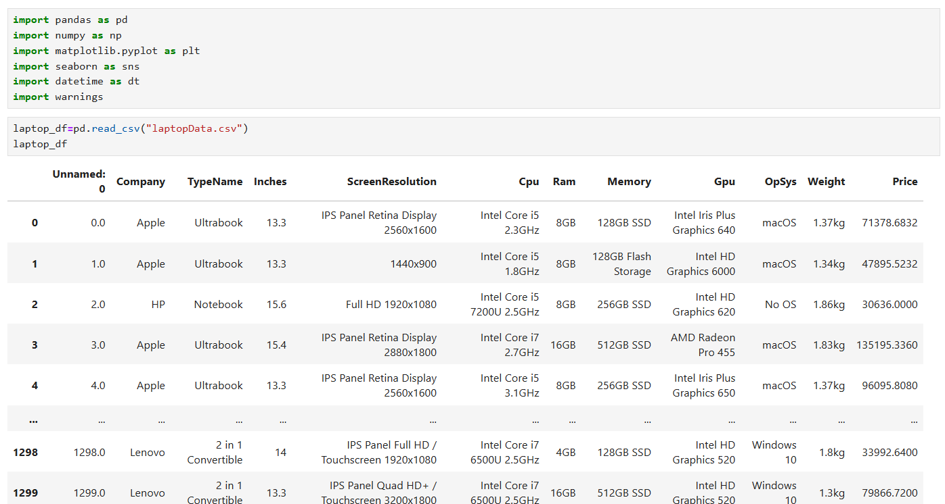

Data Cleaning
Necessity: Data cleaning ensures accuracy and consistency, which are crucial for reliable analysis.
Steps Taken:
Handled missing values
Corrected inconsistent data entries
Standardized units of measurement
Removed duplicate records.​

Slide 5

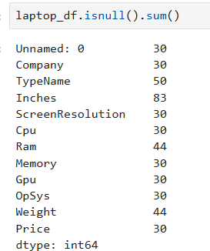
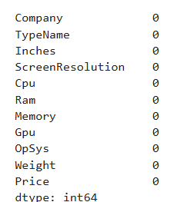
Handling Missing Values
Approach:
Identified missing values using data profiling techniques.
Applied appropriate imputation methods (mean, median) or removed records with excessive missing data.​
Methods Used:
Mean/Median Imputation.​
Deletion of records with significant missing information.​

Slide 6


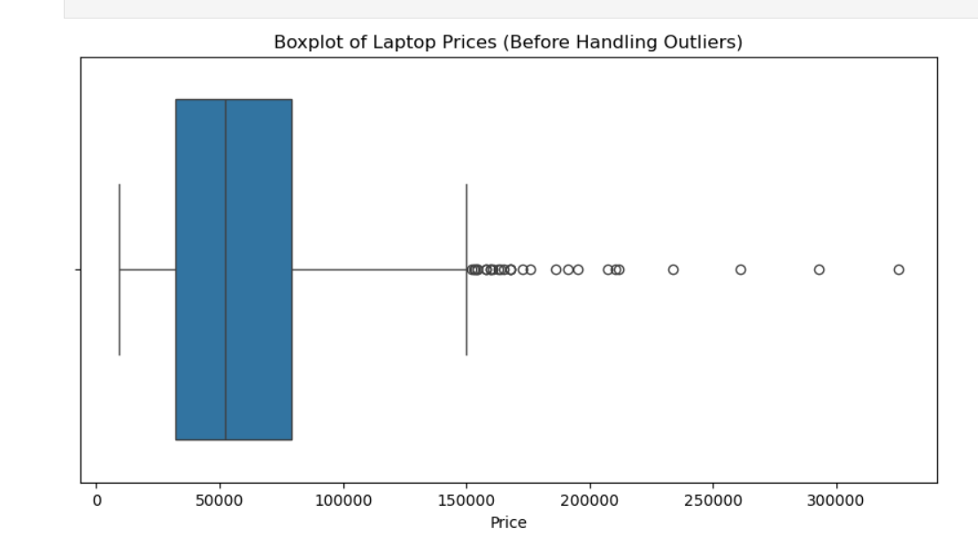
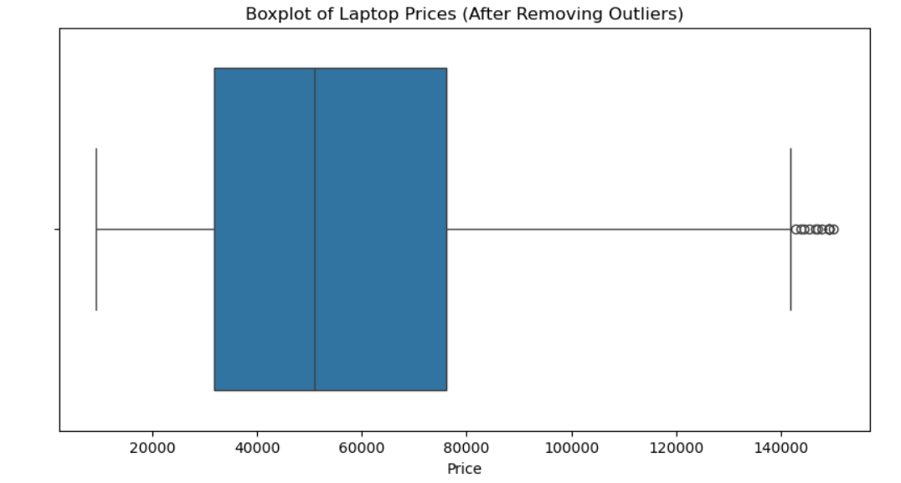
Outlier Handling
Identification:
Used statistical methods like IQR to detect outliers.​

Slide 7

Handling Invalid Values
Addressing Invalid Data:
Detected incorrect entries (e.g., negative prices, unrealistic RAM sizes).
Corrected or removed invalid data points to maintain data integrity.​
Methods Used:
Data validation rules.​
Cross-referencing with reliable sources for verification.​

Slide 8


Statistical Analysis
Overview:
Conducted descriptive statistics to summarize data.
Performed inferential statistics to understand relationships between variables.​
Hypothesis Testing:
Used t-tests to compare means between groups (e.g., different RAM sizes).​
Applied chi-square tests to examine associations between categorical variables (e.g., brand and operating system).​

Slide 9
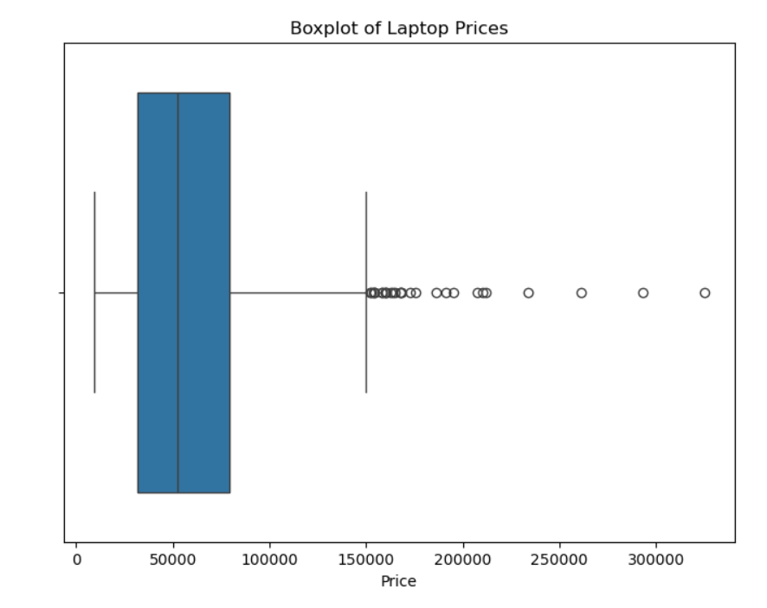
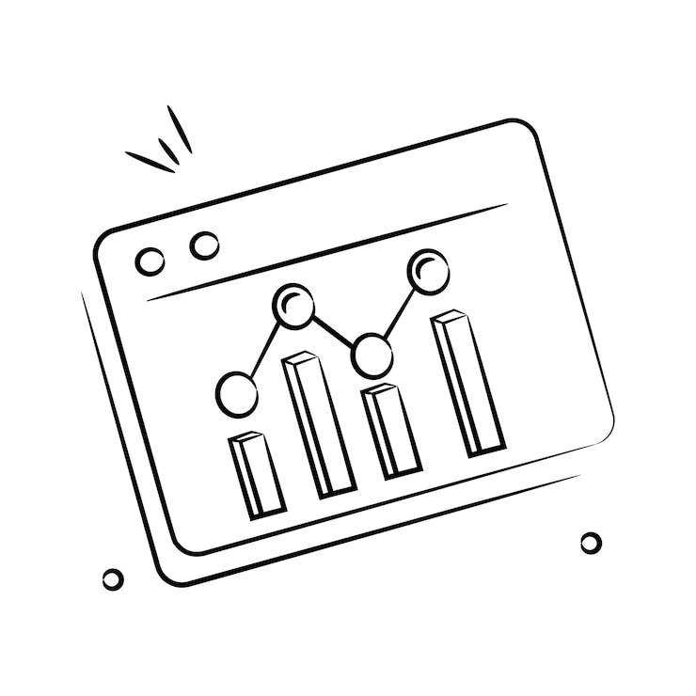
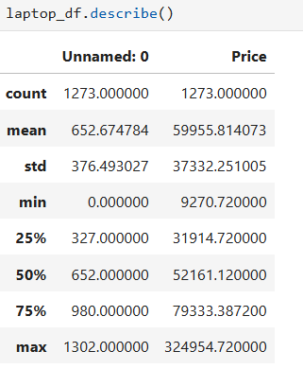
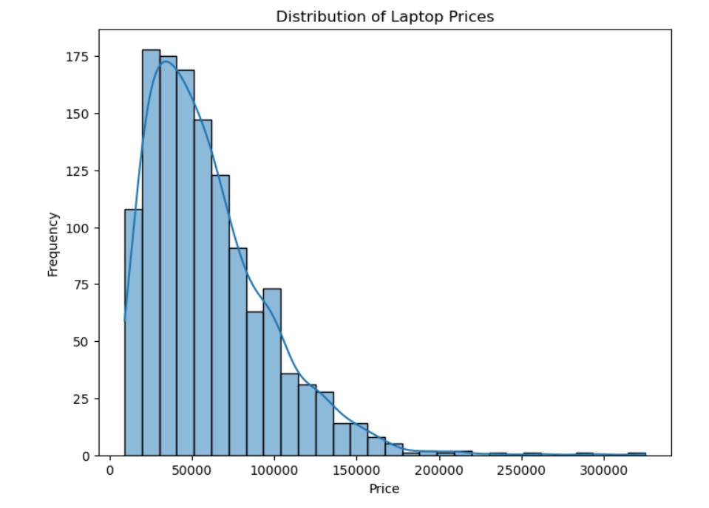
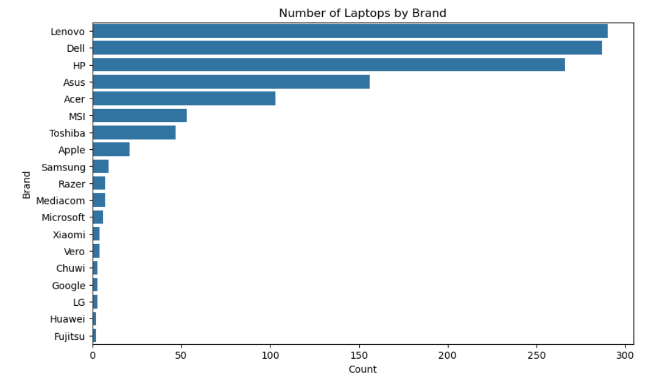
Descriptive Analysis

Slide 10
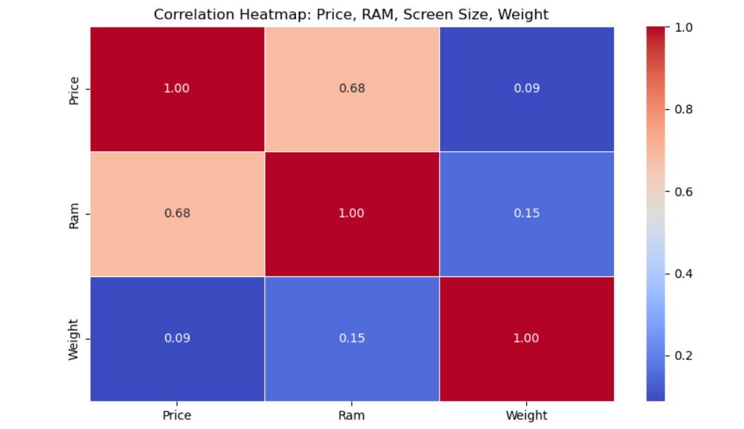
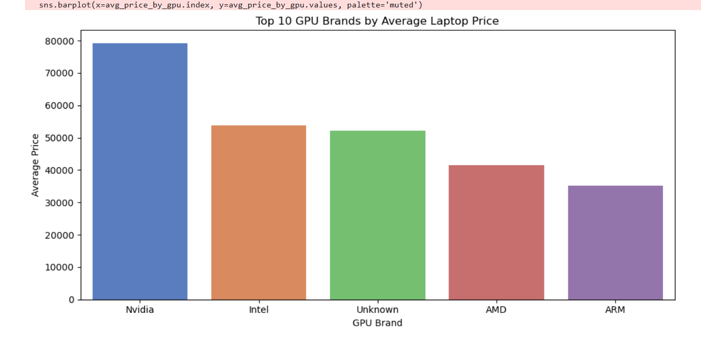
Relationships Between Variables

Slide 11
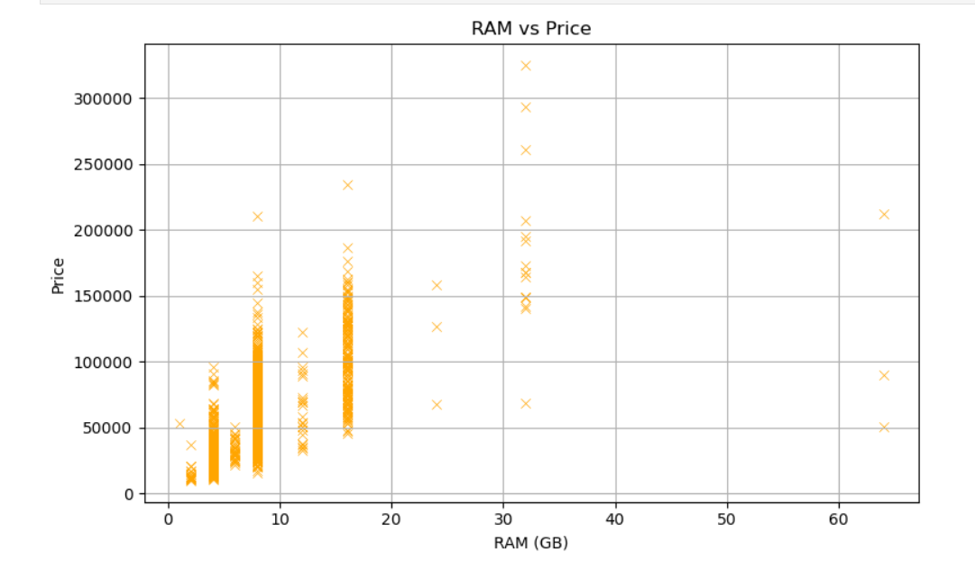
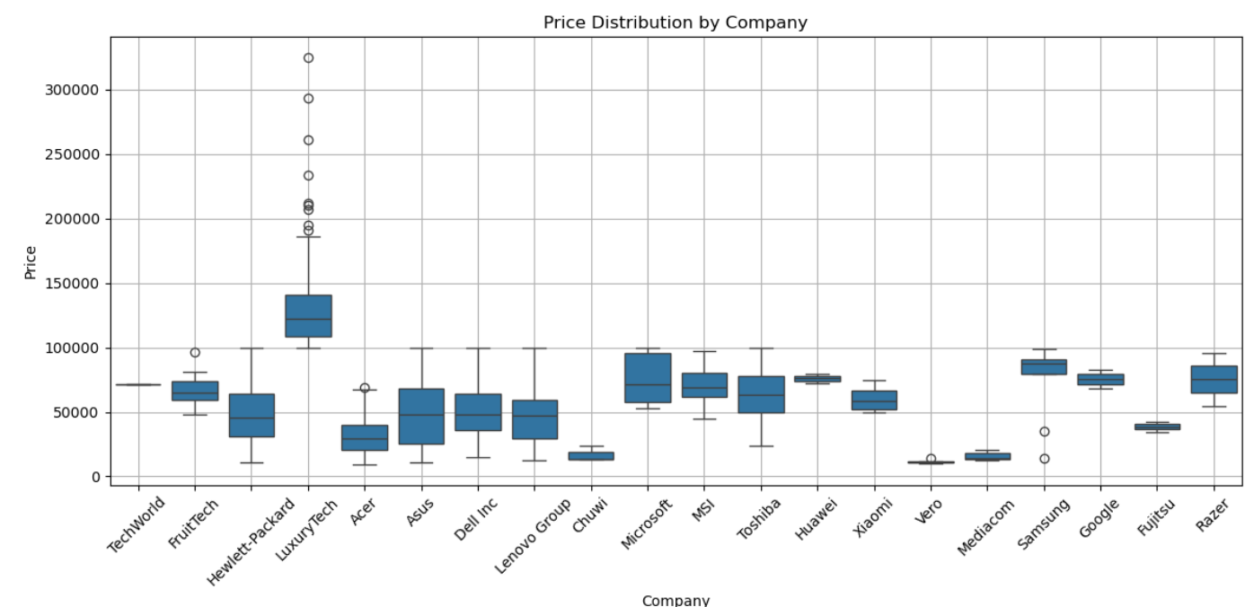
Data Visualization

Slide 12
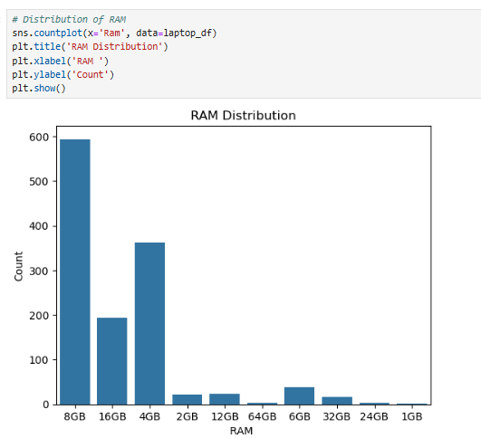
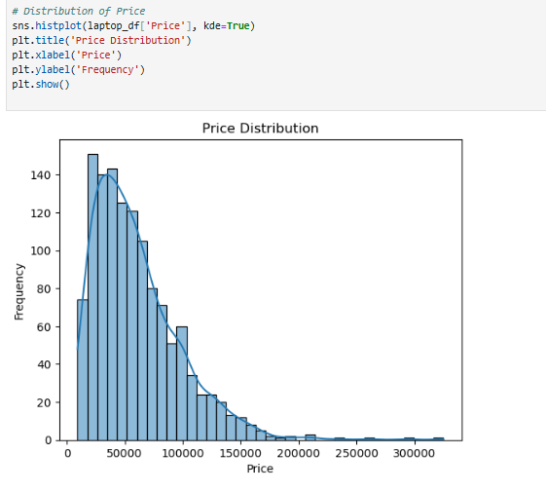
Univariate Analysis

Slide 13
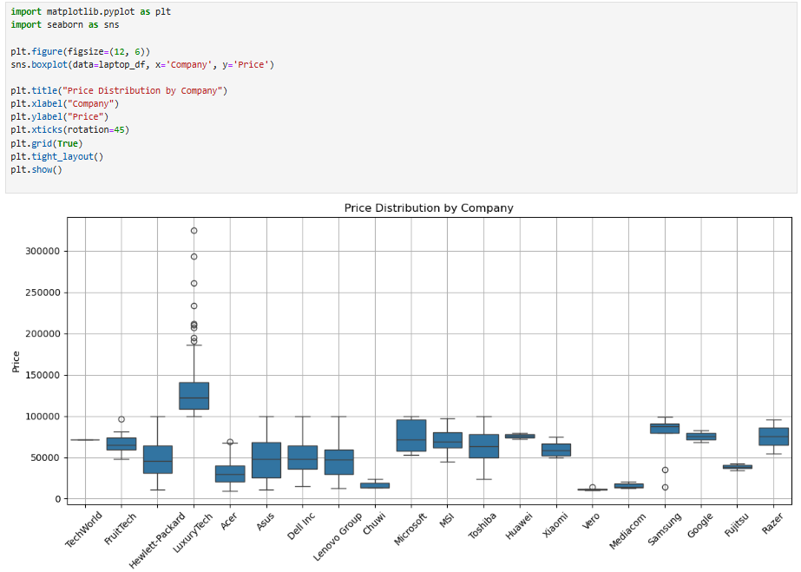
Bivariate Analysis

Slide 14
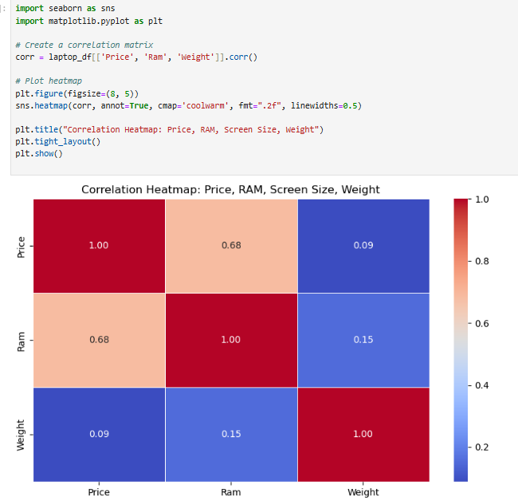
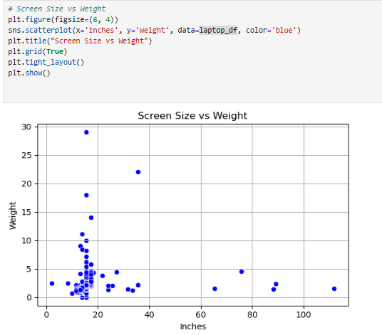
Multivariate Analysis

Slide 15
Feature Engineering:
Extracted the processor tier (e.g., i3, i5, i7, Ryzen 5) from the CPU string.
CPU:
Total Storage:
Sample CPU | Extracted (CPU Types)
Intel Core i5 2.3GHz | i5
Intel Core i7 2.7GHz | i7
AMD Ryzen 5 2500U | Ryzen 5
Intel Celeron Dual Core N4000 | Other
Memory | Total Storage (GB)
128GB SSD | 128
512GB SSD | 512
1TB HDD + 256GB SSD | 1256
Brand Tier:
Company | Brand Tier
Apple | High-end
HP | Mid-range
Acer | Budget
Dell | High-end
Asus | Mid-range

Slide 16


